Slide 1
Do Tossed Coins Tend to Land on the Side They Started?
Iver Jiang

Slide 2
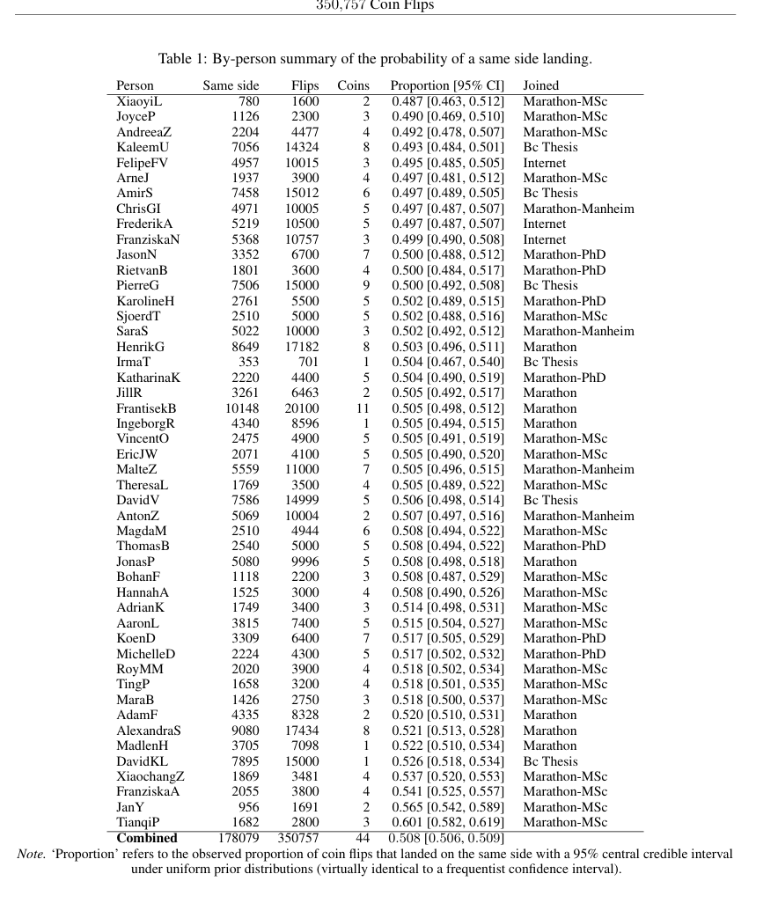
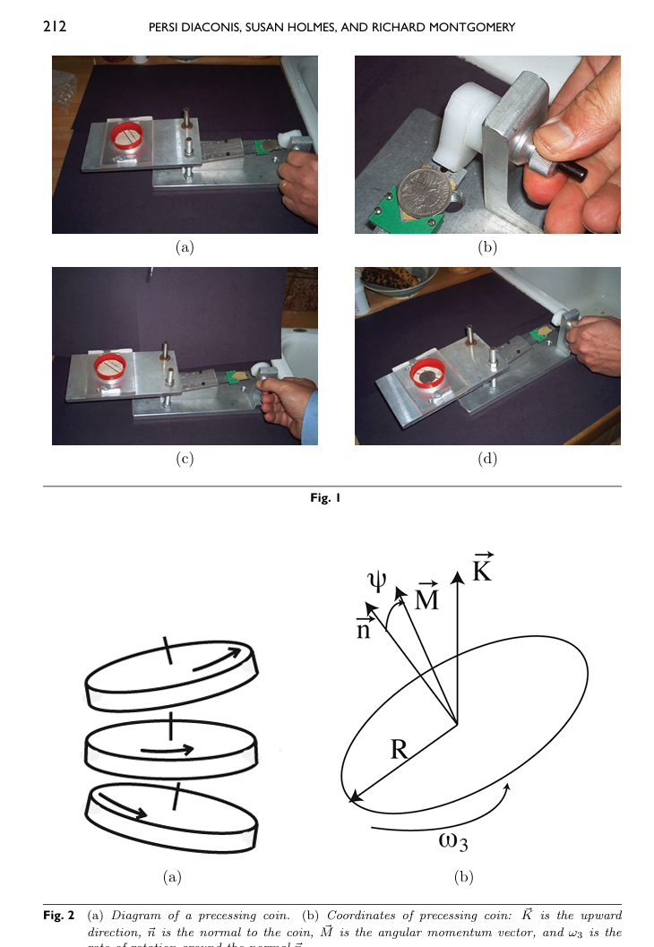

Slide 3
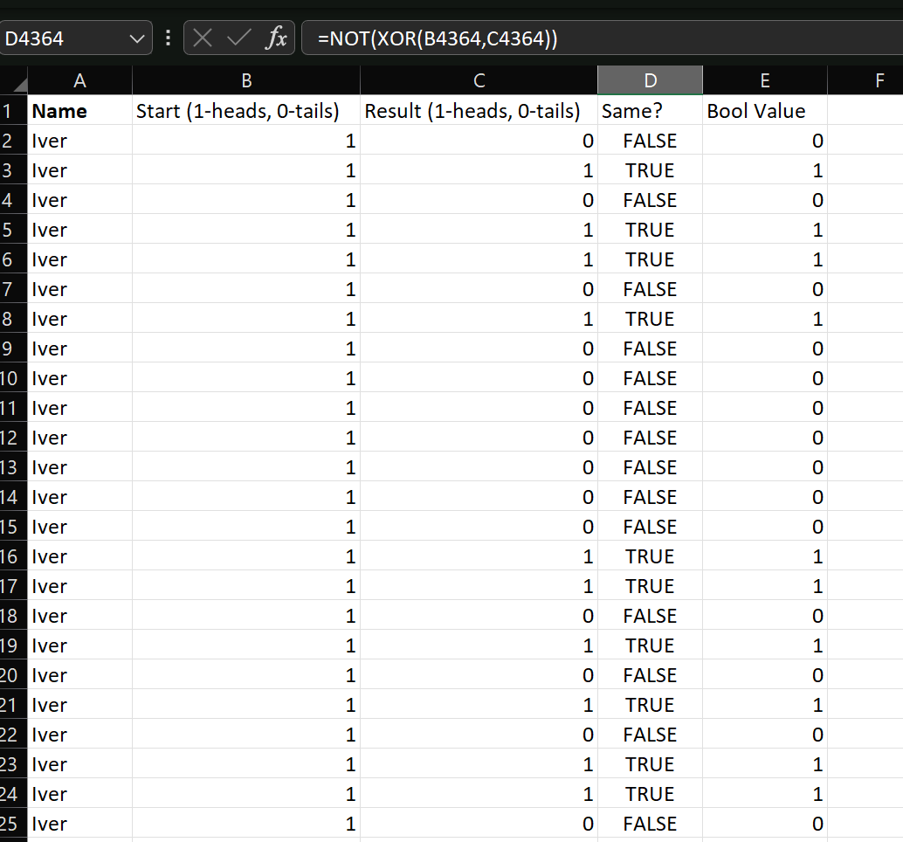

Slide 4
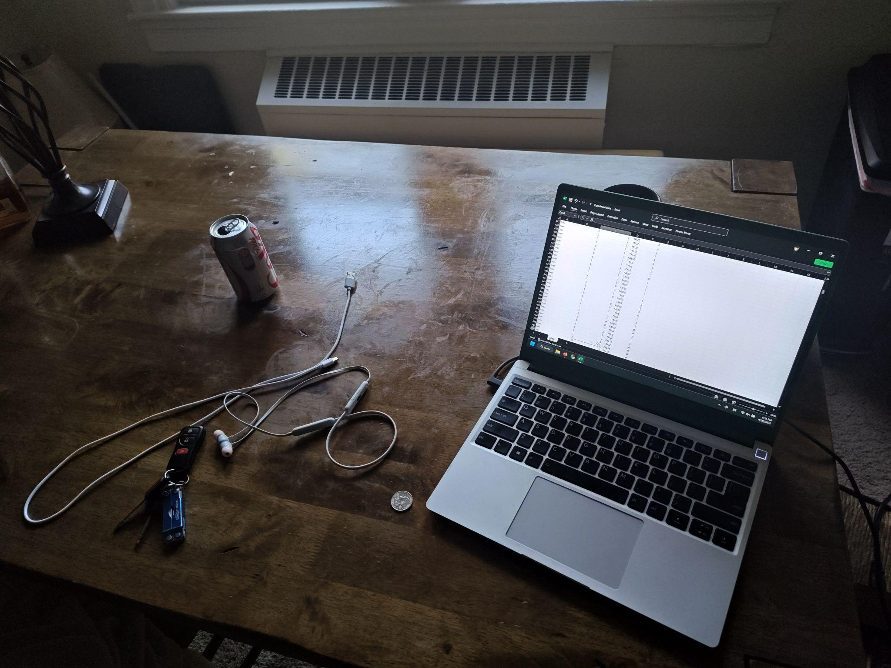

Slide 5
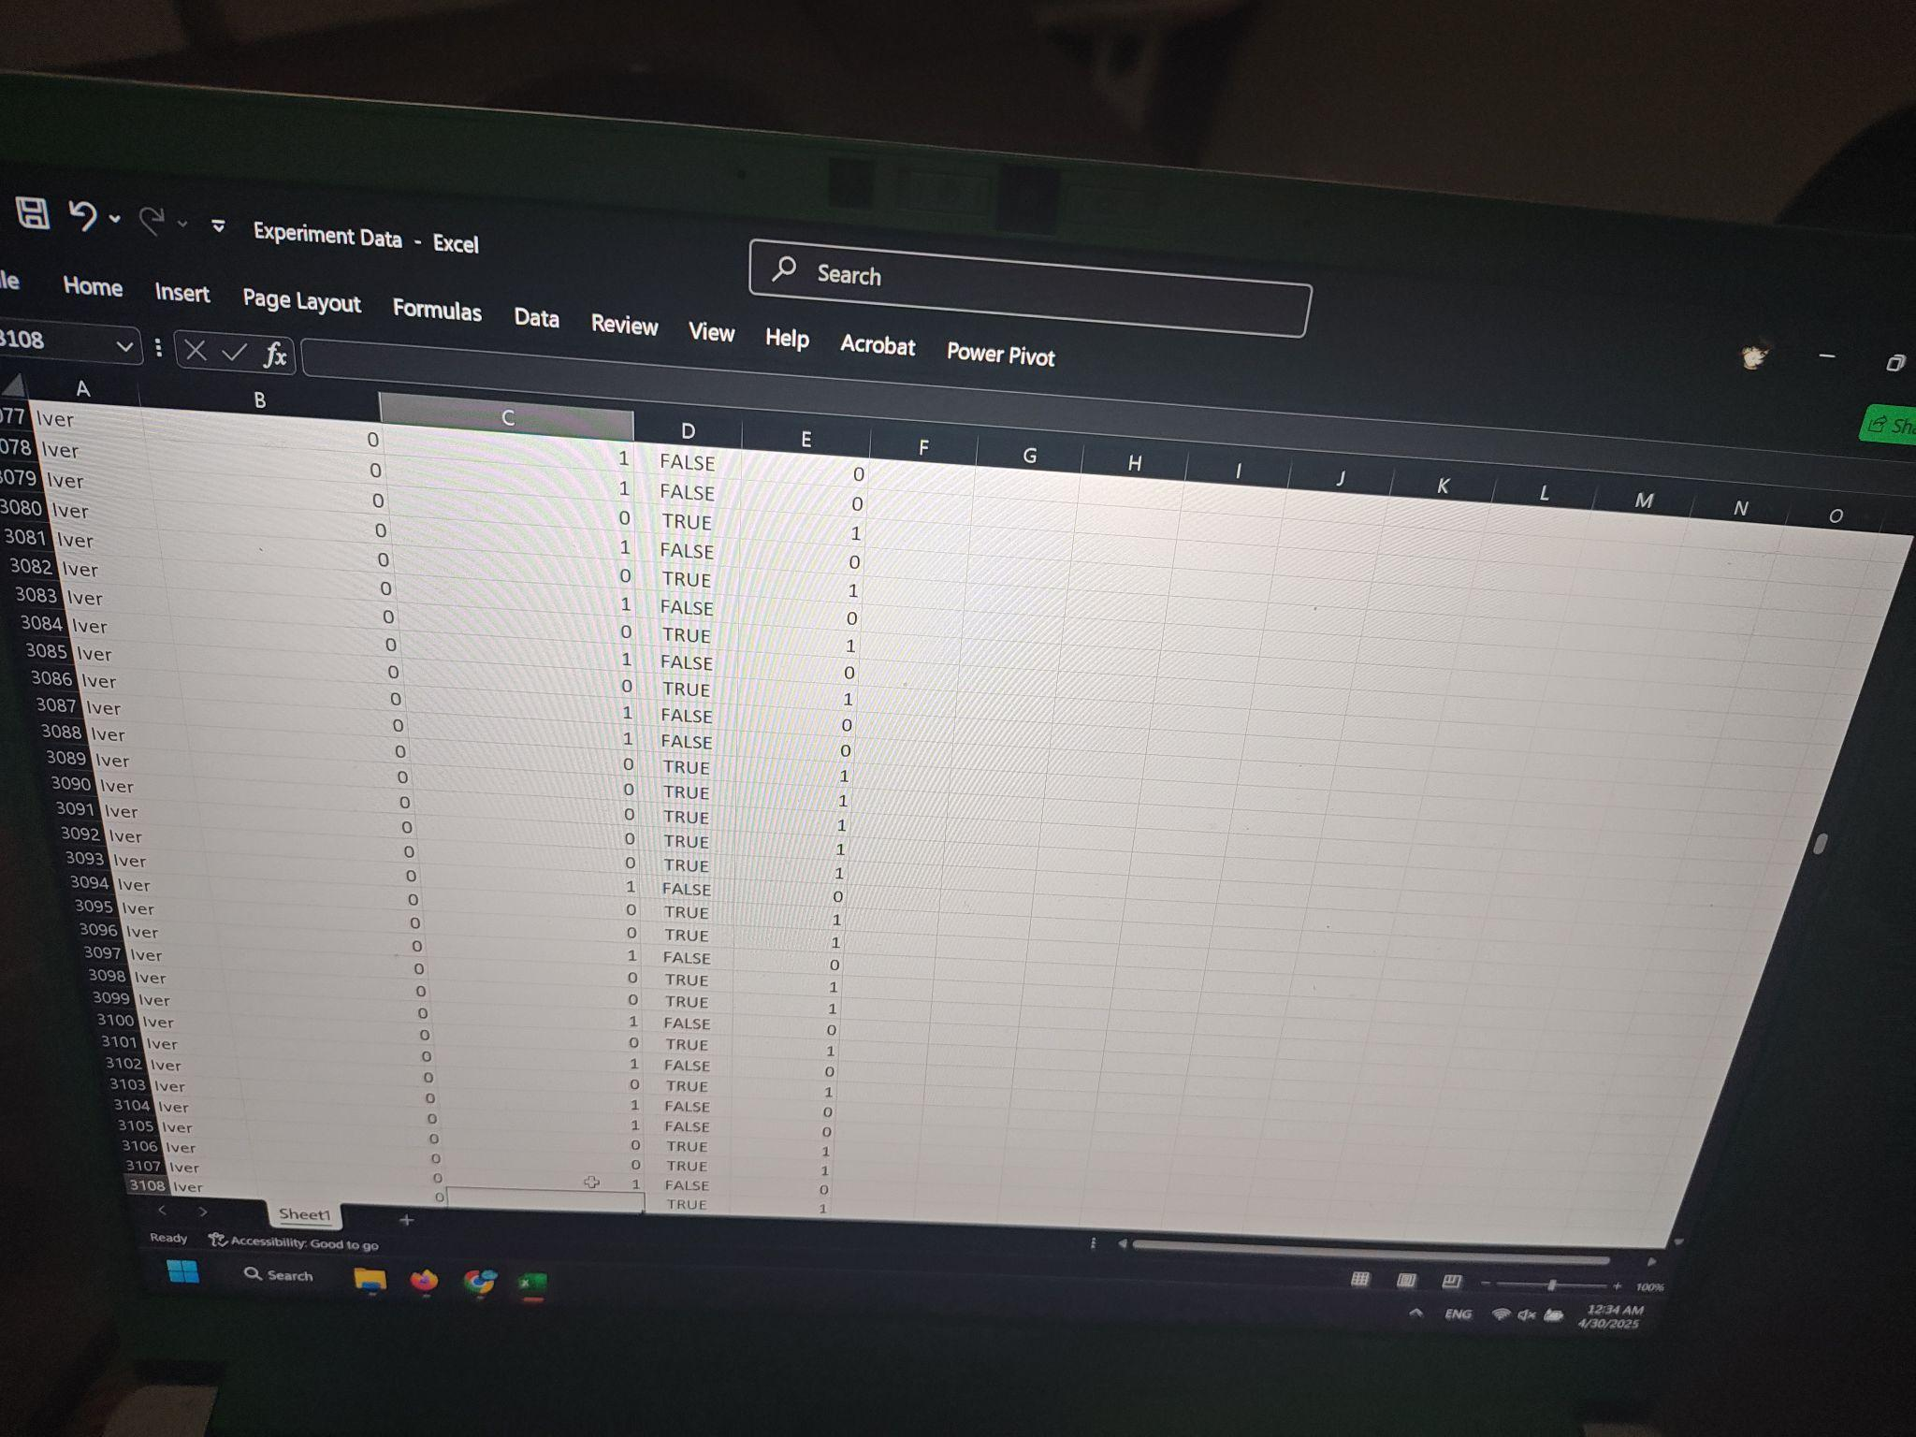

Slide 6
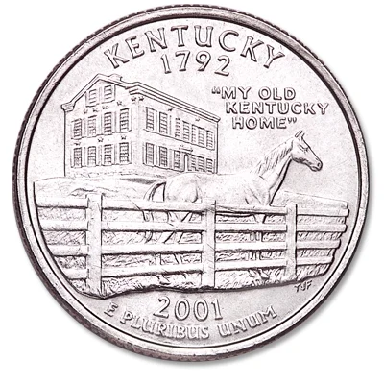
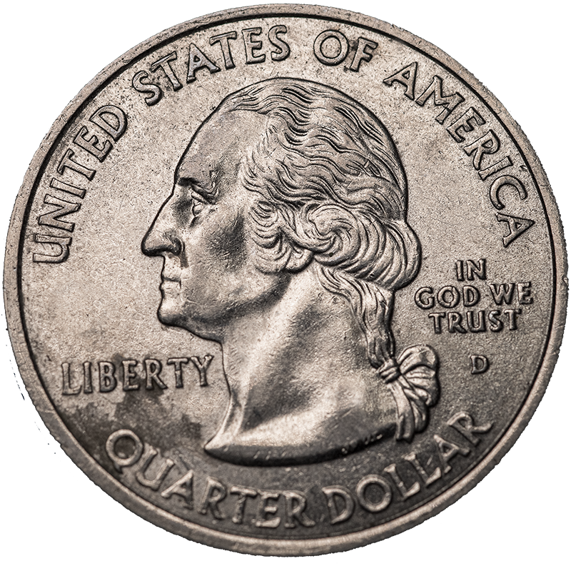

Slide 7
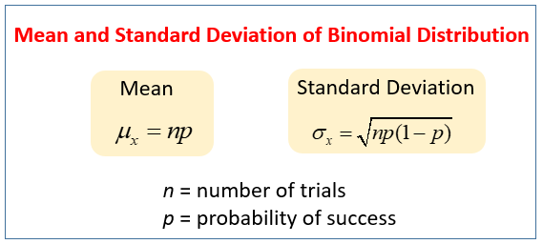

Slide 8
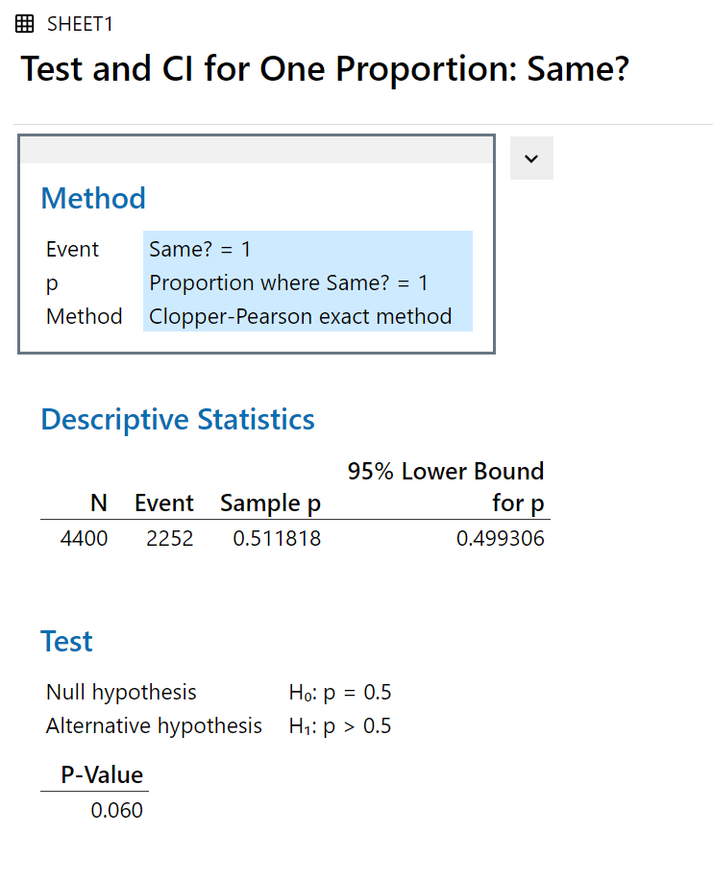
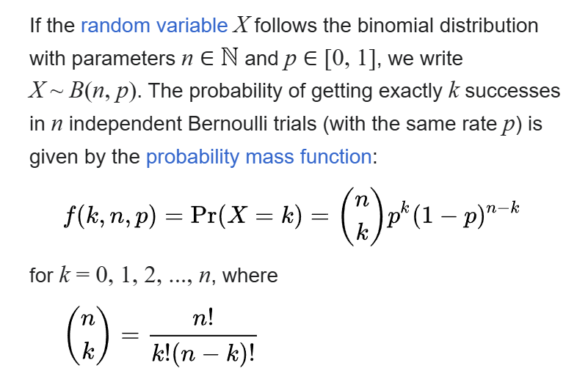
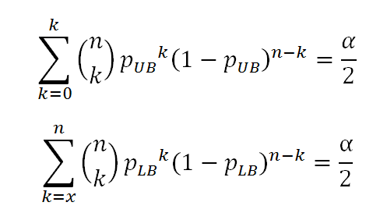
n: Number of trials
x: amount of successes
K: every single possibility of success
LB: lower bound
UB: upper bound

Slide 9
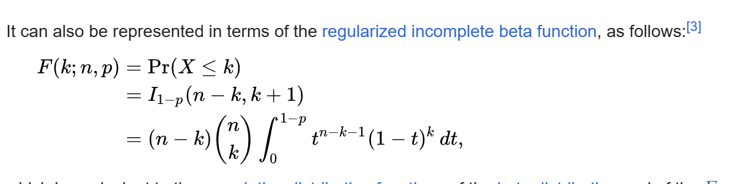
n: Number of trials
p: given probability of events (successes)
k : number of actual successes

Slide 10
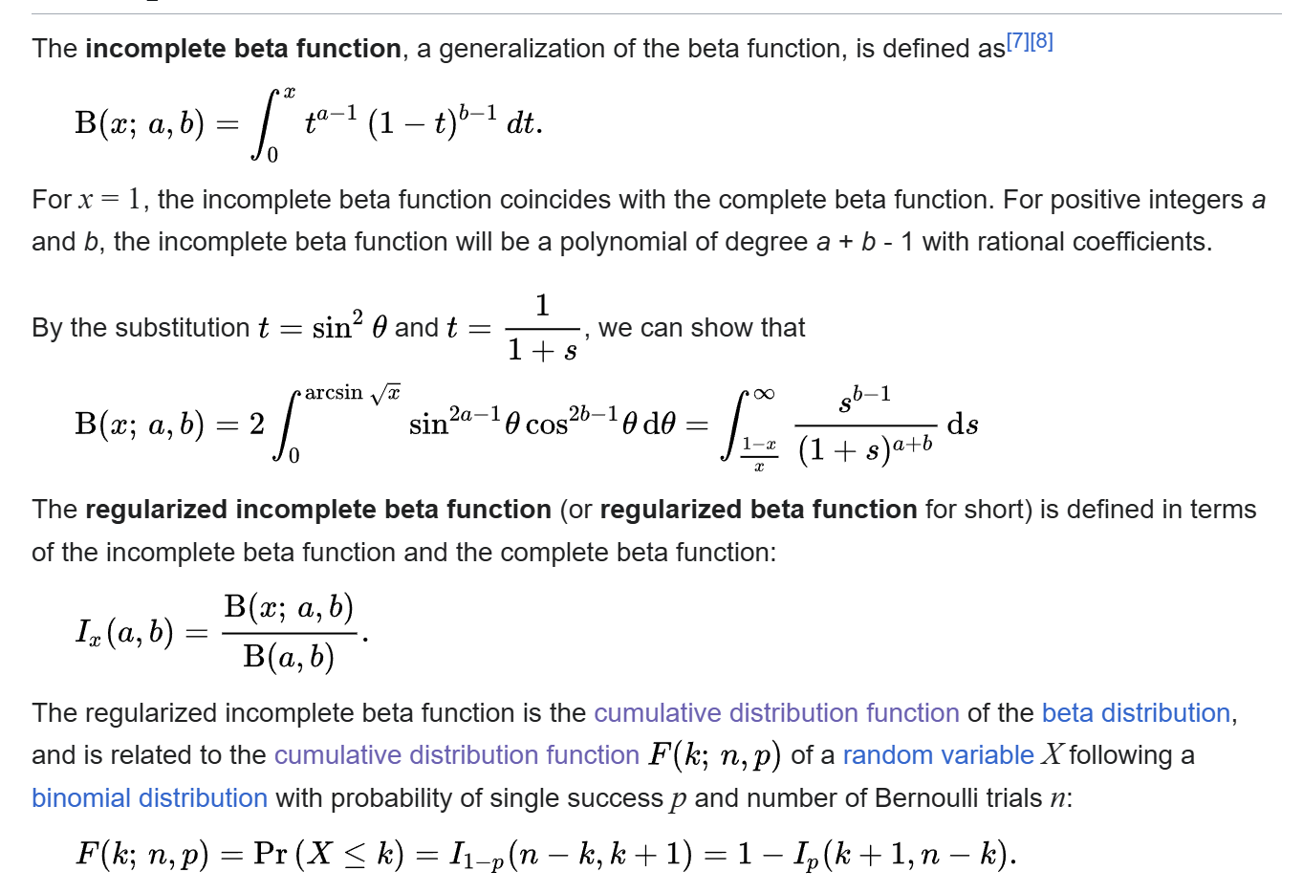

Slide 11
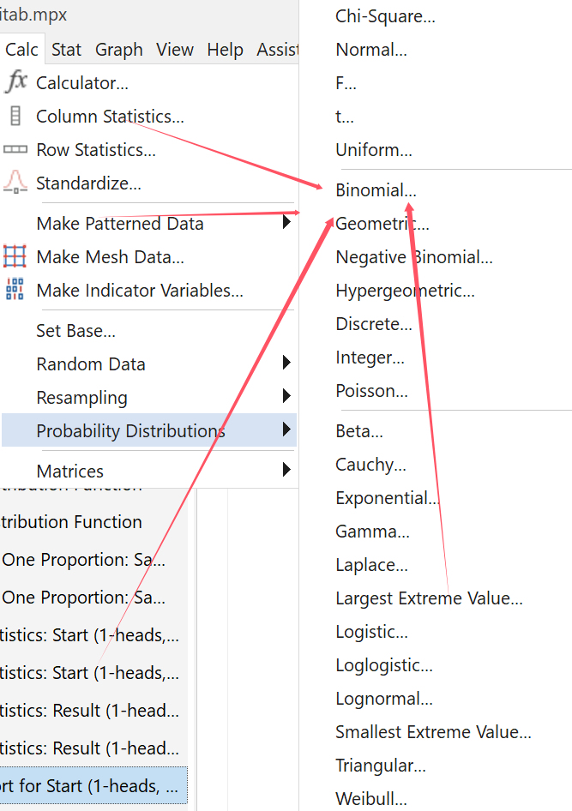

Slide 12

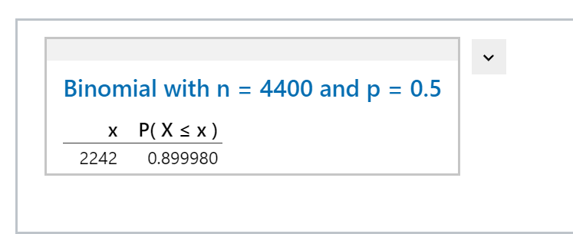

Slide 13
Results!
Maybe? (Depending on Alpha…)

Slide 14
Bibliography:
1. František Bartoš et al. Fair Coins Tend to Land on the Same Side They Started: Evidence from 350,757 Flips. https://arxiv.org/abs/2310.04153, 2023
2. Persi Diaconis et al. Dynamic Bias in the Coin Toss. https://www.stat.berkeley.edu/~aldous/157/Papers/diaconis_coinbias.pdf, 2007

Slide 15
